Slide 1

HOMELESSNESS INSIGHTS DASHBOARD: HACKNEY VS. NINE NEIGHBOURING BOROUGHS (Q1 2025)
OSAGIE ELLIOT AIBANGBEE
September 3rd, 2025
Notes:
Good day everyone, my name is Osagie Aibangbee. I’m presenting the report titled:

Slide 2
STRUCTURE OF PROJECT PRESENTATION
SLIDE 3 & 4: AIMS & OBJECTIVES
SLIDE 5: PROJECT PROCESS OVERVIEW
SLIDE 6: TOOLS USED
SLIDES 7 - 9: ETL METHODOLOGY
SLIDE 10 - 15: ANALYSIS & INTERPRETATION
SLIDE 16: RECOMMENDATIONS
Notes:
Here is the outline of this report presentation, in which there are 5 sections (as listed in this slide).

Slide 3
AIMS
To provide valuable insights into homelessness trends and inform effective prevention strategies across Hackney and nine neighbouring local authorities.
Notes:
The aim of this presentation is:

Slide 4
OBJECTIVES
To analyse Prevention and Relief Duty outcomes between Q2 2024 and Q1 2025.
To compare Hackney’s performance against nine neighbouring boroughs.
To identify key drivers of temporary accommodation use.
To recommend data-informed strategies for reducing homelessness.
Notes:
The aims of this research are as follows:
To find out the relationship that exists between fifth follow-up BMI and Enroll-HD variables.
To compare the performance of a trained logistic regression (logit) and support vector machine (SVM) models in predicting fifth follow-up BMI classes in terms of accuracy, recall, precision, and f1-score.

Slide 5

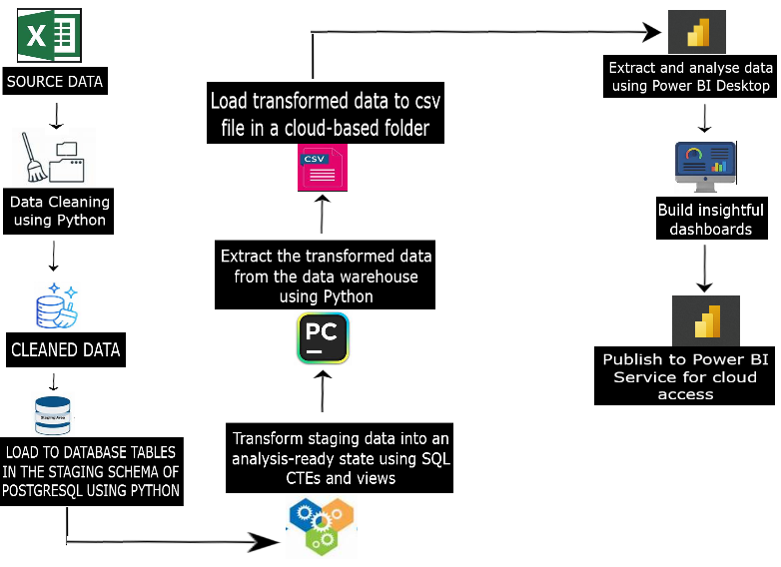
PROJECT PROCESS OVERVIEW
Notes:
Here is the overall flow-chart representation of the entire development process.
The data containing national information about prevention and relief duty outcomes in the UK was extracted from 4 Excel files and then cleaned and formatted in preparation for transformation and aggregation using Python.
Core transformation was achieved using SQL queries and stored as views in the database.
Final output of the transformation was extracted and stored in a cloud folder with a Python script.
Insightful dashboards were built using Power BI Desktop.
Finally, the dashboards were published to Power BI Service for cloud access.

Slide 6
TOOLS USED
PyCharm IDE: Used for creating and running Python scripts.
PostgreSQL & PgAdmin4: Used for writing and executing SQL queries.
Power BI & Power Query: Used for building automated dashboards using DAX and M language.
OneDrive & OneLake: Used for secure, cloud-based data storage and access.
PowerPoint: Used to deliver the presentation
Notes:
Listed here are the tools used at different stages of this project.

Slide 7
ETL ALGORITHMIC STEPS
Python:
Extract source data from Excel file into a source DataFrame Drop completely empty rows and almost empty columns Map columns to appropriate column names Remove duplicate records Keep only relevant columns Drop blank system_id rows Drop almost empty rows Engineer quarter_indicator, is_neighbouring_la columns Replace system placeholder for missing values “..” with more intuitive ”” Recast columns to appropriate data types Repeat previous steps for remaining files and append final output to the same source DataFrame | Engineer a delta column to identify uniqueness of each row based on its content for source DataFrame Connect to and extract existing data from a corresponding database table into a destination DataFrame Enforce data type consistency between source and destination DataFrames Engineer a delta column to identify uniqueness of each row based on its content for destination DataFrame Compare delta columns of both DataFrames only keeping rows in the source DataFrame where data is fresh Load fresh data from source DataFrame into target data warehouse table in the database Refresh and load final output of transformations in the data warehouse into a DataFrame Load data from DataFrame to CSV file stored in a cloud-based folder
Notes:
Listed here are the tools used at different stages of this project.

Slide 8
DATA TRANSFORMATION ALGORITHMIC STEPS
SQL:
Get data from staging table of interest Using the is_neighbouring_la column, select only records of the following local authorities: Southwark, Islington, Haringey, Lambeth, Tower Hamlets, Camden, Waltham Forest, Hammersmith & Fulham, and Newham Calculate aggregated metrics (average) for selected records Engineer columns system_id and local_authority for calculated aggregates to enable merging with more granular council records Append grouped records to Hackney’s Calculate percentages for metrics Engineer year_qtr to enhance axis sorting in dashboard visuals Unpivot metric columns into two columns named “metrics” (categorical) and “households” (values) Pivot unique values of the local_authority into separate columns hackney_la and neighbouring_la Store result as view
Notes:
Listed here are the tools used at different stages of this project.

Slide 9
DATA VISUALISATION ALGORITHMIC STEPS
POWER BI & POWER QUERY:
Get data from from cloud-based CSV file using Query Editor Use appropriate row as header Remove redundant prefix/suffix from metrics column Close and apply query results on Query Editor to Power BI Report Calculate measures using DAX Build dynamic dashboard visuals Publish to Power BI Service
Notes:
Listed here are the tools used at different stages of this project.

Slide 10
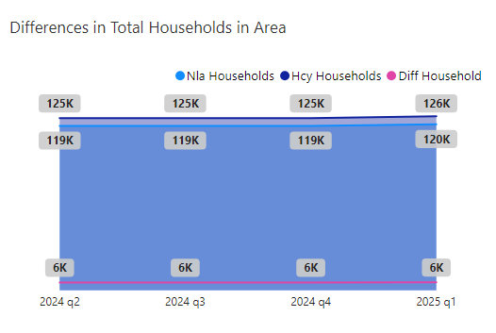
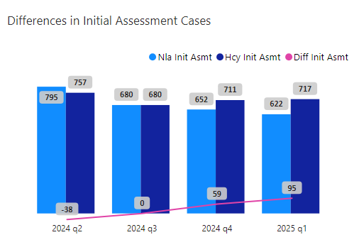
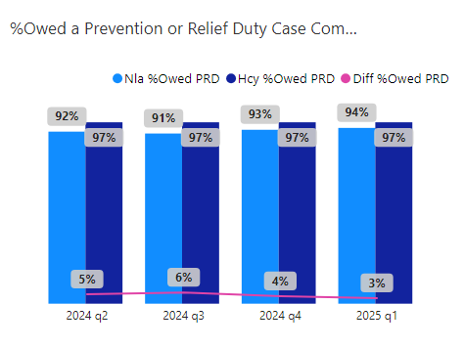
HOMELESSNESS NEEDS/DEMAND
Hackney and nearby LA
Rise in household population in Q1 2025
Only 1% of total household applied for homelessness assistance
Hackney
Assessment outcome was constantly 97% owed a duty
Effective application process.
Nearby LA initial assessment downward trend vs Hackney’s gradually rising trend

Slide 11
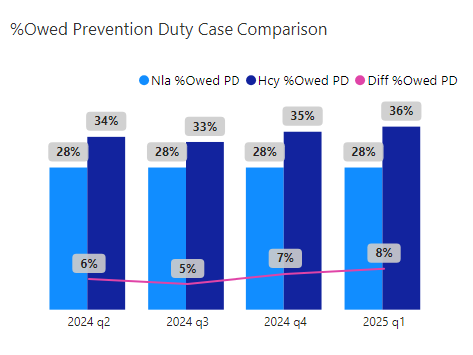
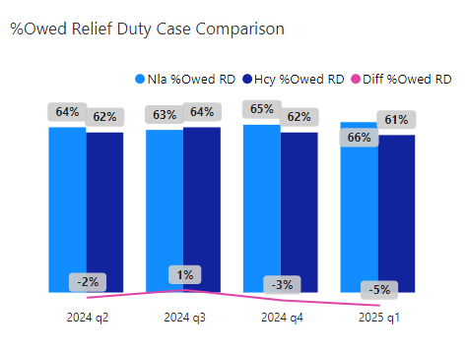
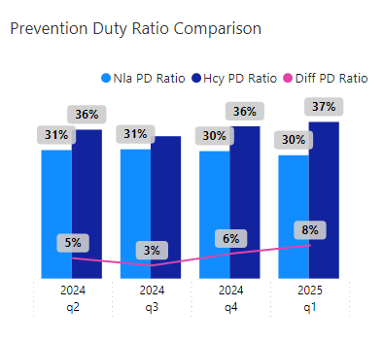
PREVENTION & RELIEF DUTY APPLICATIONS
Hackney applicant proactivity
Higher proportion of prevention duty applications
Better understanding of application requirements
Nearby LA
Higher proportion of relief duty applications
Communicate application requirements more effectively
Notes:
Here is a list of selected features in the Enroll-HD dataset used in this research.
Some of the derived features are:
CAP score: a product of larger allele CAG and age.
CCC: a sum of the medical history of an individual’s clinical impairment or behavioural problems.
Ages of onset: (for example, ccmtrage means age of onset of motor impairment).
Tetrabenazine use, Treated Chorea, Swallowing Therapy, Took High Calorie Supplements, GI illness: all indicate a medical history of drug use, treatment for chorea, receiving swallowing therapy, et cetera.
Chorea score: sum of chorface, chorbol, chortrunk, chorrue, chorlue, chorrle, chorlle.
Cognitive score: sum of an individual’s performance at sdmt1, verfct5, scnt1, swrt1.
Behaviour score: sum of an individual’s exfscore, aptscore, depscore, irascore, & psyscore. The meaning of these individual psychiatric evaluation measures are detailed in the Enroll-HD data dictionary.

Slide 12
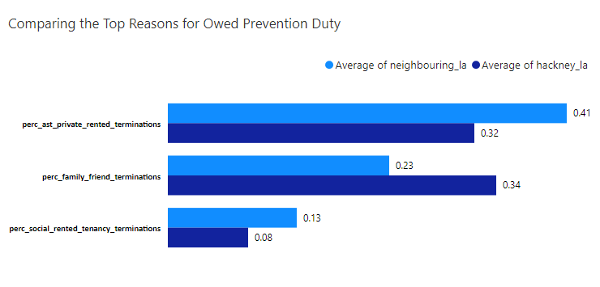
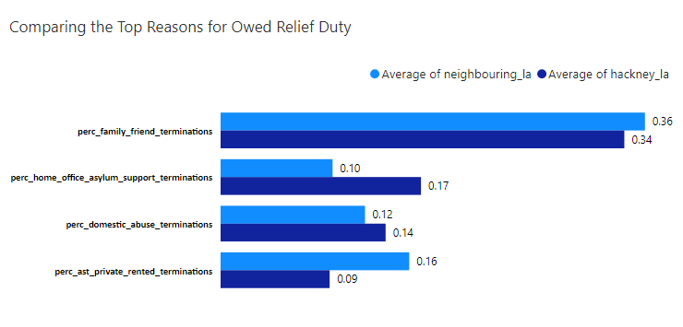
DRIVERS OF PREVENTION & RELIEF DUTY APPLICATIONS
Hackney and nearby LA
Top 3 causes of PD applications:
End of AST, F/F, End of SRT
Top 4 causes of RD applications
F/F, HOA, Domestic Abuse, End of AST
Hackney
F/F is leading cause of homelessness (prevention + relief)
Notes:
Here is a list of selected features in the Enroll-HD dataset used in this research.
Some of the derived features are:
CAP score: a product of larger allele CAG and age.
CCC: a sum of the medical history of an individual’s clinical impairment or behavioural problems.
Ages of onset: (for example, ccmtrage means age of onset of motor impairment).
Tetrabenazine use, Treated Chorea, Swallowing Therapy, Took High Calorie Supplements, GI illness: all indicate a medical history of drug use, treatment for chorea, receiving swallowing therapy, et cetera.
Chorea score: sum of chorface, chorbol, chortrunk, chorrue, chorlue, chorrle, chorlle.
Cognitive score: sum of an individual’s performance at sdmt1, verfct5, scnt1, swrt1.
Behaviour score: sum of an individual’s exfscore, aptscore, depscore, irascore, & psyscore. The meaning of these individual psychiatric evaluation measures are detailed in the Enroll-HD data dictionary.

Slide 13
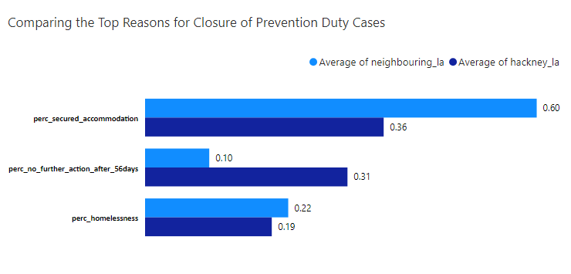
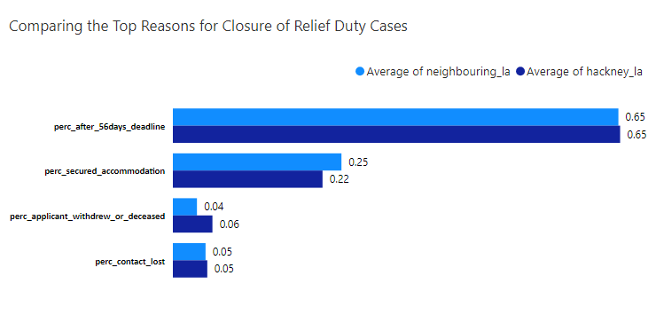
DRIVERS OF ENDED PREVENTION & RELIEF DUTY
Hackney and nearby LA
Top 3 drivers of ended PD:
Secured Accommodation, NFA, Homelessness
Top 4 drivers of ended RD
56 Days Elapsed, Secured Accommodation, Applicant Withdrew or Deceased, Lost Contact
Hackney
Better at tenancy retention
Worse at securing accommodation
Notes:
Here is a list of selected features in the Enroll-HD dataset used in this research.
Some of the derived features are:
CAP score: a product of larger allele CAG and age.
CCC: a sum of the medical history of an individual’s clinical impairment or behavioural problems.
Ages of onset: (for example, ccmtrage means age of onset of motor impairment).
Tetrabenazine use, Treated Chorea, Swallowing Therapy, Took High Calorie Supplements, GI illness: all indicate a medical history of drug use, treatment for chorea, receiving swallowing therapy, et cetera.
Chorea score: sum of chorface, chorbol, chortrunk, chorrue, chorlue, chorrle, chorlle.
Cognitive score: sum of an individual’s performance at sdmt1, verfct5, scnt1, swrt1.
Behaviour score: sum of an individual’s exfscore, aptscore, depscore, irascore, & psyscore. The meaning of these individual psychiatric evaluation measures are detailed in the Enroll-HD data dictionary.

Slide 14
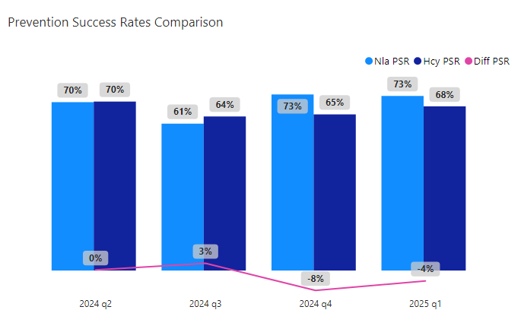
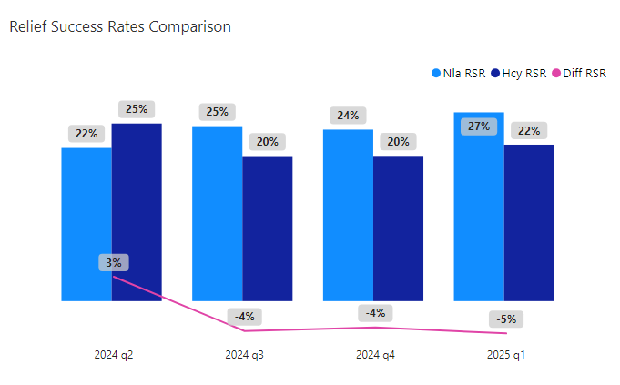
EVALUATION OF PREVENTION & RELIEF EFFORTS
Hackney
Higher number of successful cases
5% lower PSR and RSR (worse)
Weaker overall performance in preventing and relieving homelessness
Neighbouring LA
Lower number of successful cases
Better PSR and RSR
Stronger overall performance in preventing and relieving homelessness
Notes:
Here is a list of selected features in the Enroll-HD dataset used in this research.
Some of the derived features are:
CAP score: a product of larger allele CAG and age.
CCC: a sum of the medical history of an individual’s clinical impairment or behavioural problems.
Ages of onset: (for example, ccmtrage means age of onset of motor impairment).
Tetrabenazine use, Treated Chorea, Swallowing Therapy, Took High Calorie Supplements, GI illness: all indicate a medical history of drug use, treatment for chorea, receiving swallowing therapy, et cetera.
Chorea score: sum of chorface, chorbol, chortrunk, chorrue, chorlue, chorrle, chorlle.
Cognitive score: sum of an individual’s performance at sdmt1, verfct5, scnt1, swrt1.
Behaviour score: sum of an individual’s exfscore, aptscore, depscore, irascore, & psyscore. The meaning of these individual psychiatric evaluation measures are detailed in the Enroll-HD data dictionary.

Slide 15
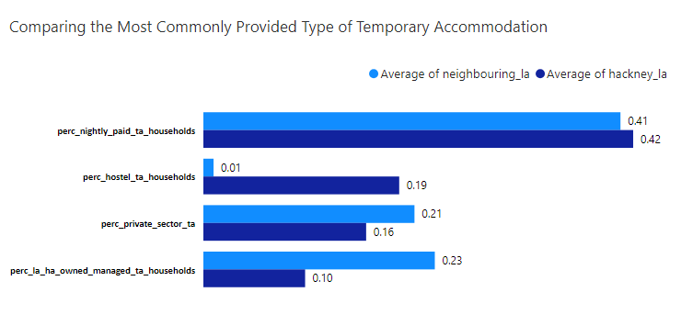
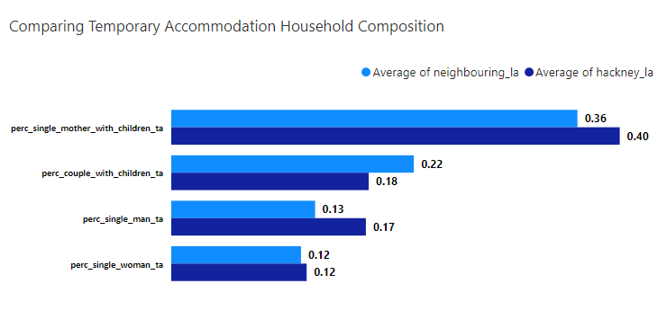
TEMPORARY ACCOMMODATION
Hackney had 5% more TA households
Hackney and nearby LA
Top 4 TA types:
NPM, Hostels, LA/HA stock, PSAL
Hackney is under-utilising its LA/HA stock
Top 4 household composition in TA:
SMDC, CDC, SM, SW
Approximately 3 out of 5 households in TA involve dependent children
Hackney’s SM are 5% higher in TA
Notes:
Here is a list of selected features in the Enroll-HD dataset used in this research.
Some of the derived features are:
CAP score: a product of larger allele CAG and age.
CCC: a sum of the medical history of an individual’s clinical impairment or behavioural problems.
Ages of onset: (for example, ccmtrage means age of onset of motor impairment).
Tetrabenazine use, Treated Chorea, Swallowing Therapy, Took High Calorie Supplements, GI illness: all indicate a medical history of drug use, treatment for chorea, receiving swallowing therapy, et cetera.
Chorea score: sum of chorface, chorbol, chortrunk, chorrue, chorlue, chorrle, chorlle.
Cognitive score: sum of an individual’s performance at sdmt1, verfct5, scnt1, swrt1.
Behaviour score: sum of an individual’s exfscore, aptscore, depscore, irascore, & psyscore. The meaning of these individual psychiatric evaluation measures are detailed in the Enroll-HD data dictionary.

Slide 16
RECOMMENDATIONS
Educate households on importance of encouraging friends or family members to apply early for their own housing options while relationships are still positive.
Encourage household members to report early signs of domestic abuse to help identify potential risks of homelessness and enable timely preventive measures.
Strengthen the council’s capacity to secure accommodation and expand its use of LA/HA stock to reduce reliance on more expensive alternatives.
Direct greater investment towards reducing the length of time families spend in temporary accommodation, in order to minimize the negative impact on growing children.
Investigate the root causes of unexpectedly high use of temporary accommodation by single adult males.
Notes:
In conclusion:
This research serves to further improve the understanding of factors responsible for the change in BMI as it affects manifest HD individuals.
The result of this classification task confirms the superiority of the SVM over the GLM, especially when dealing with a high-dimensional dataset with multiple classes as in this case.
CCC (combined clinical characteristics) and combined feedself, both novel derived variables, were found to be relevant predictors of BMI in addition to other established variables such as baseline BMI, CAP score, age of onset of clinical impairments (motor, cognitive, etc.), and others listed in table 1.
While the predictive influence of variables like cross-sectional chorea, baseline age, and gender appeared to be minimal.
The insights gained from this work can serve as a background for future investigations, as more data become available, we are likely to unravel more causal relationships within the Enroll-HD variables.

Slide 17
THANK
YOU
FOR
LISTENING

